Slide 1
Parking Detection Application Using Ultrasonic Sensor in Dewan Kuliah Pusat Parking Area
Final Year Project 2 (FYP2)
Faculty of Computing and Informatic (FCI)
Elvin Louie Chiew (BI17110042)
HC05 Network Engineering

Slide 2


Content
Introduction
Problem Statement
Design
Objective
Preliminary Implementation
Methodology
Research Experiments
Conclusion

Slide 3

Introduction
The average time spent to look for a parking space are 25 minutes.
The numbers of cars keep increasing every year, but number of parking spaces barely increase.
Ultrasonic sensors is used because the cost is relatively lower compared to the other method

Slide 4
Problem Statement
There is no application that can be used by the staffs and students to monitor the parking spaces around DKP area
Finding parking spaces consume a lot of the motorist time, especially if they are new to the area.

Slide 5


Objectives
To study the requirement for parking occupancy detection system application using Node MCU.
To design and develop a prototype application that allow the users monitor the parking space availability
To test the functionality of the system application.

Slide 6
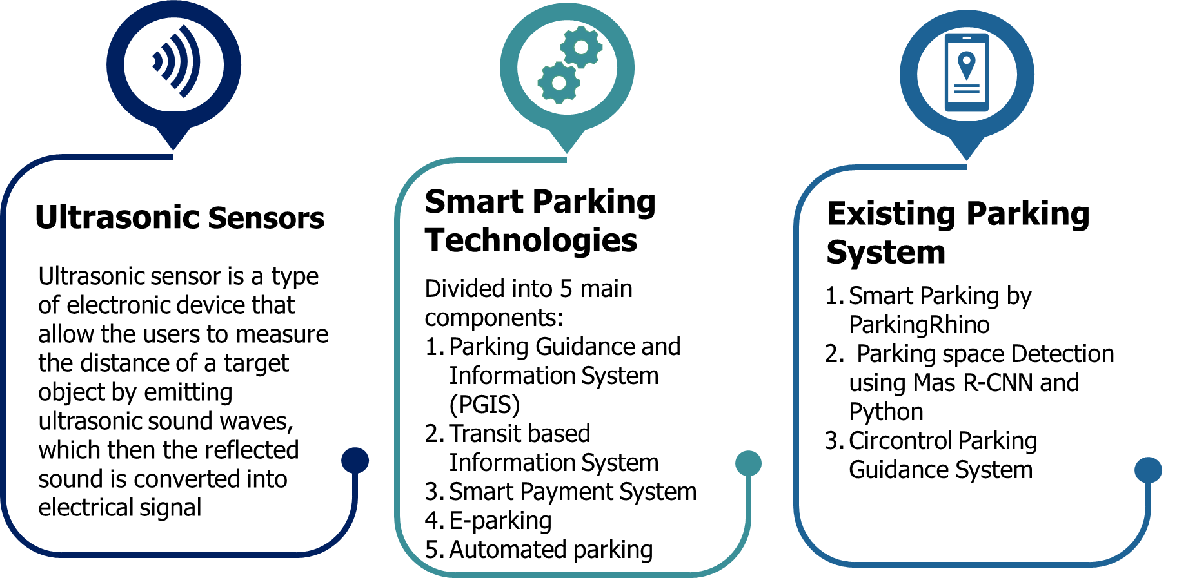
Literature Review

Slide 7


So, Why NodeMCU?
It is independent of platform
Its cost effective
Open source software
Because of NodeMCU is cross-platform, it can support operating system such as MAC, Window and Linux.
The cost of NodeMCU board is cheaper compared to other type of bord
.
C++ programming language can be used in Arduino IDE. Thus, the library can be embedded directly into the program.

Slide 8
Development Board Comparison
 | Arduino UNO | Raspberry Pi | ESP8266 Node MCU
Developer | Arduino | Raspberry Pi Foundation | The ESP8266 community (open source)
Type | Single board microcontroller | Mini computer | Single board microcontroller
Power Source | USB, Power Supply, and Battery | Power Supply, USB | USB
Operating Voltage | 5V | 5V | 3.3V
Storage | 1KB | Slot for MicroSDHC | 4MB
Price | RM23.90 | RM156.00 | RM18.90

Slide 9
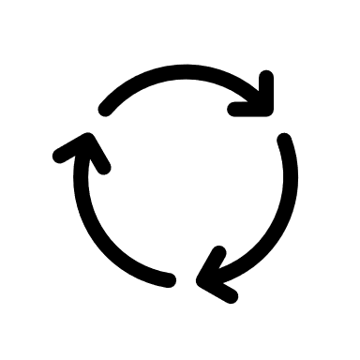
Methodology- RAD
Develop
Analysis and Design
Testing
User Design
Implementation
Demonstrate
Refine
Investigate the problem that occur regarding DKP parking area.
Distributing questionnaire to the DKP parking area user
Analyzing the suitable hardware and software that is going to be used
Design the circuit for the sensors
Design the data flow of the application development
Design the user interface of the apps.
Implementing and the application
Making sure that the system and application is connected
Documentation of the project

Slide 10
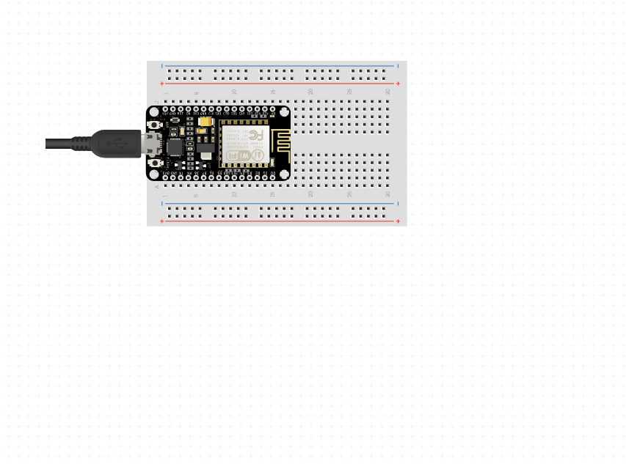
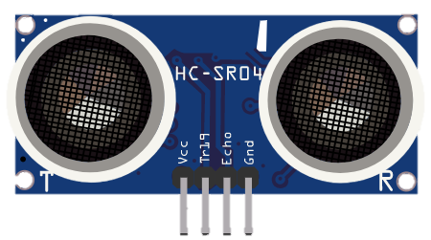
Design- Schematic Diagram
Component | Quantity | Price
Node MCU ESP8266 ESP12E Wi-fi | 1 | RM18.90
Ultrasonic sensors HC-SR04 | 2 | RM6.40
Jumper wire M-M | 1 | RM3.50
Jumper wire M-F | 1 | RM3.50
Breadboard mini | 1 | RM2.50
Total Cost = RM34.80

Slide 11

Design- Database
The database that is used in the project development is Google Firebase. This is due to several reasons:
Real-time data scalable
Flexible costs
Reduce development time and effort
and M-F)

Slide 12
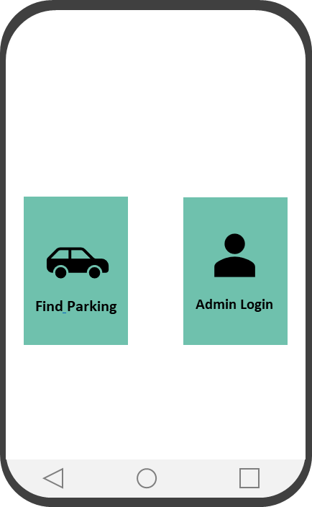
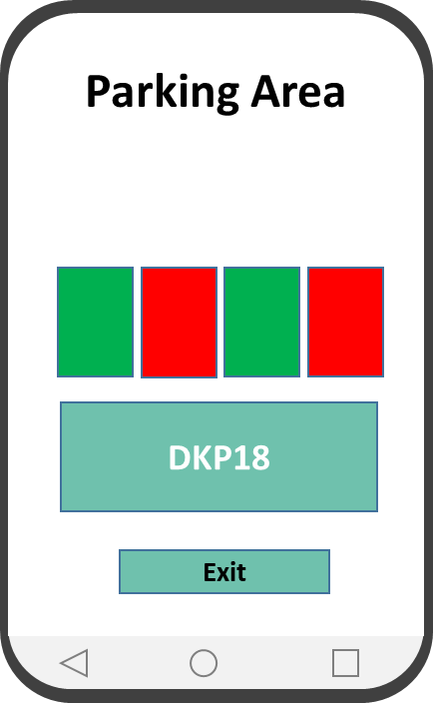
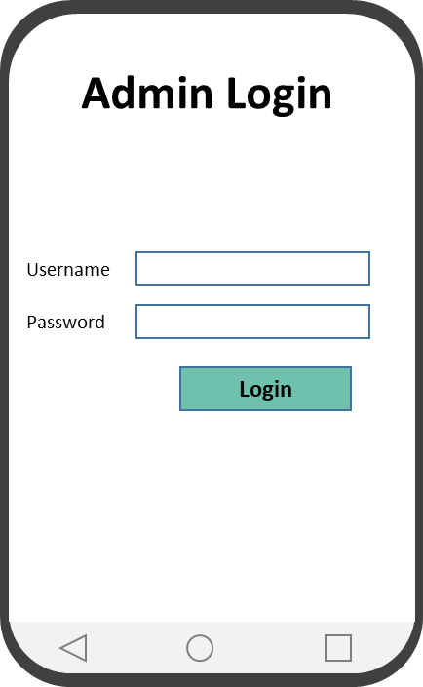
Initial UI Design

Slide 13
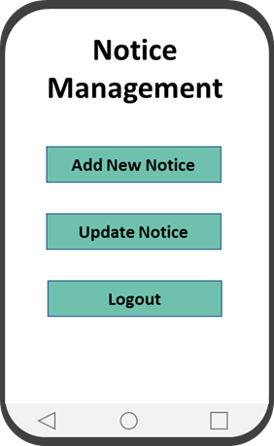
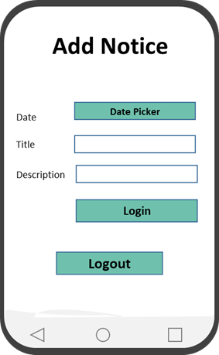
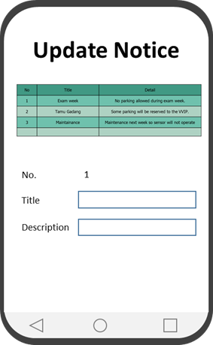
Design

Slide 14
Tests
Unit Test
Test that is run to each individual unit or component of a particular software or system
Integration Test
Test to ensure that all the module and system can work together as an integrated system.
User test
The users test the apps interface, functionalities, to perform specific tasks. The purpose is to evaluate the usability of the application system.

Slide 15
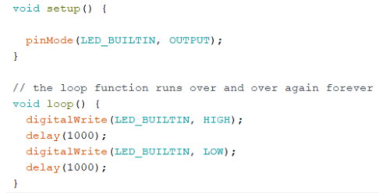
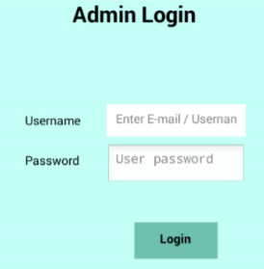
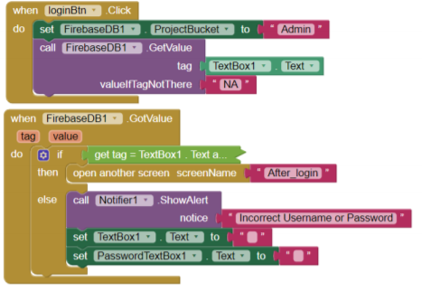
Unit Testing
Login function test
Hardware Node MCU test

Slide 16
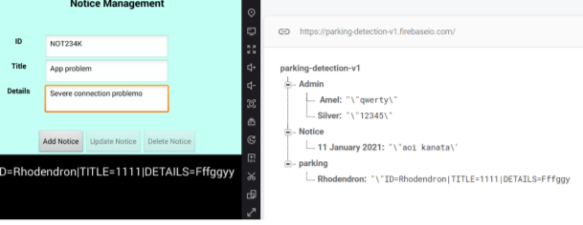
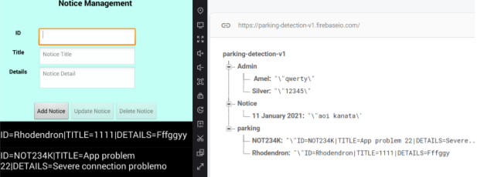
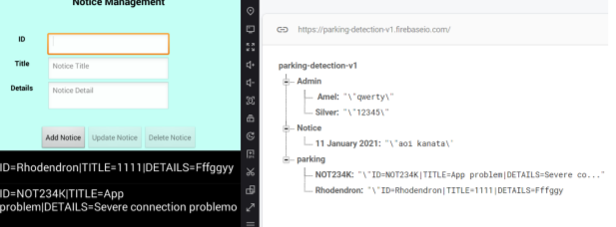
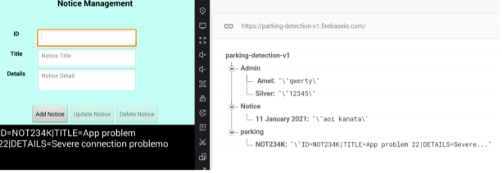
Integration test
Before addition/deletion
Insert Function
Update Function
Delete Function

Slide 17
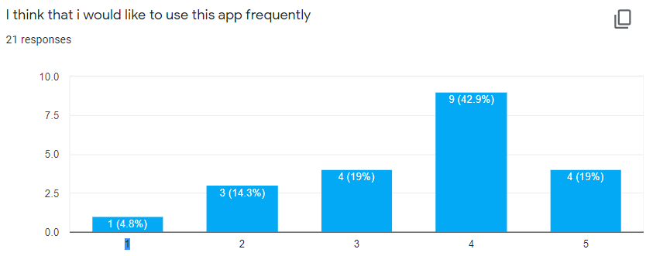
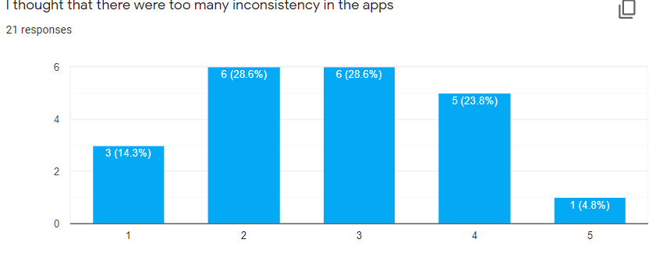
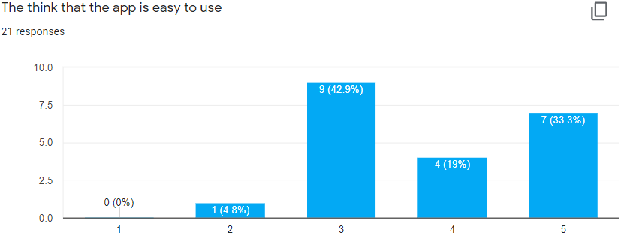
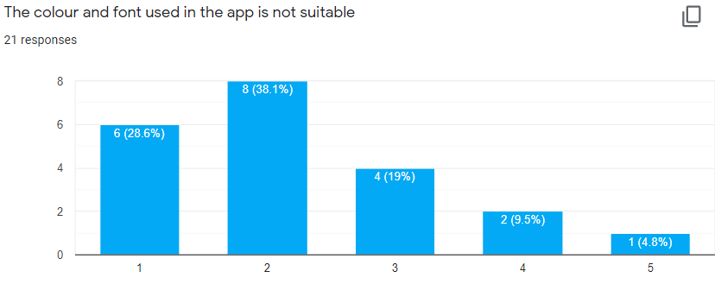
User Test

Slide 18
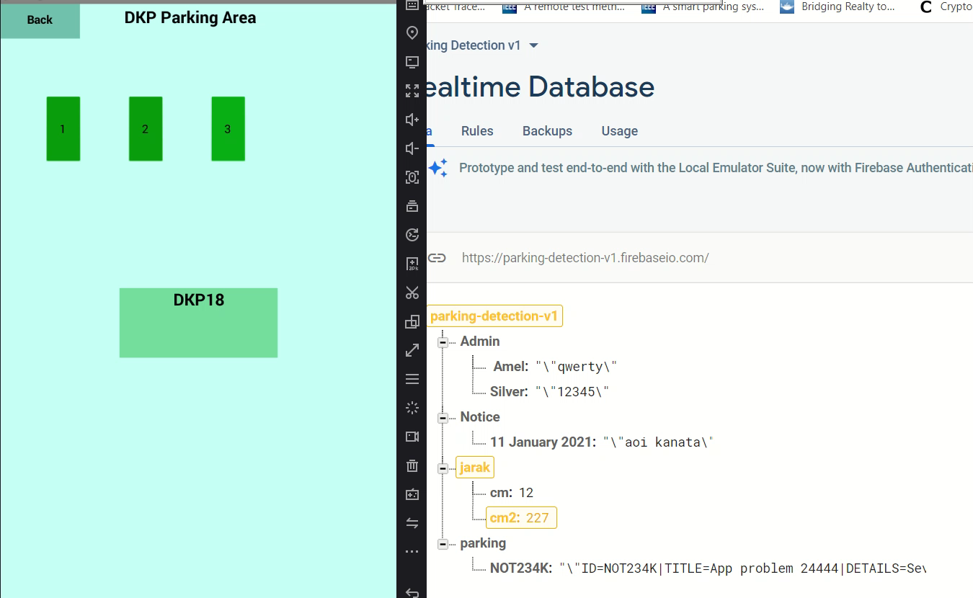
Demo Video

Slide 19
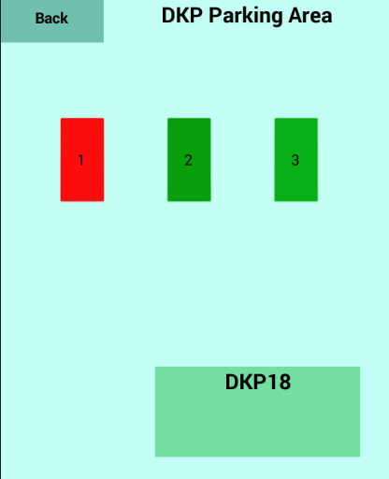
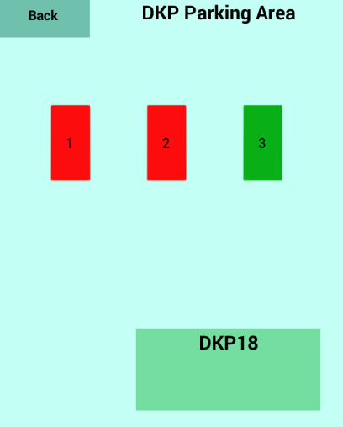
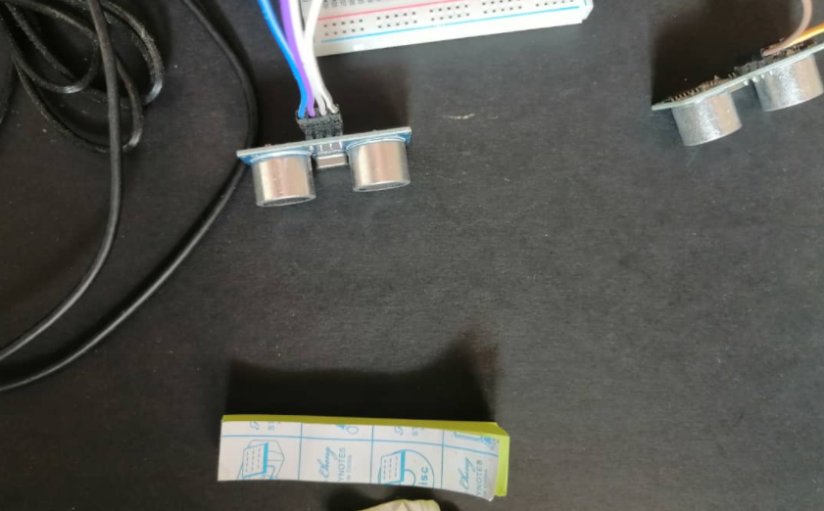
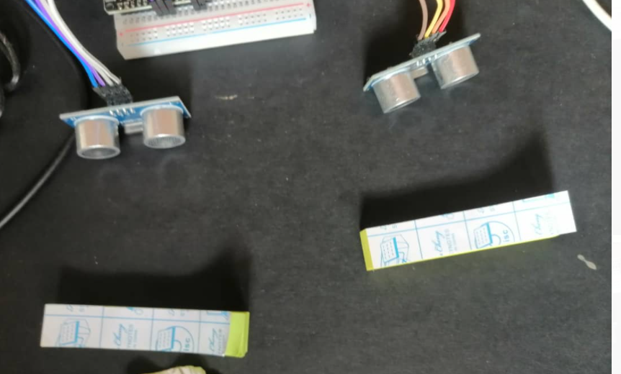

Slide 20
Discussion
For this project simulation, 10cm is being used in the arguments to detect the vehicle. This is to ensure that the precision of data. Meaning that the possibility of a passer-by trigger the sensor will be reduced.
Secondly, by using multiple ultrasonic sensor for a single parking lot, the accuracy of detection can be increase.
Thirdly using multiple ultrasonic sensors may cause it to interfere with each other. Thus, the timing for each sensor to emit the ultrasonic waves can be control to reduce the room for errors.

Slide 21
Thank You

